Slide 1

Review 1
Project Title: Music Recommendation Chatbot
Batch Number: 01 Guide Name: Dr.K.Karthikayani
Team Members: Moses C Stibu RA2111026040057
SreeVathsan D K RA2111026040058
Palak Verma RA2111027040005
29 – 07 - 2024

Slide 2
Abstract
The development of a chatbot system designed to recommend music tailored to a user's current mood. The proposed system leverages Natural Language Processing (NLP) techniques to analyze the user's textual input and identify emotional cues. Based on the perceived mood, the chatbot recommends songs aligned with the user's emotional state. This approach personalizes the music recommendation experience, enhancing the listener's enjoyment and fostering discovery of new music .By offering a conversational interaction, the chatbot can refine its recommendations through user feedback, leading to a more dynamic and engaging music exploration experience.
29 – 07 - 2024

Slide 3
Disadvantages of Existing System
Less number of tones is used
Happy ,Calm, Sad, Energetic is being used in the model.
Query related NLP is not implemented
Limited Understanding of Queries ,Poor User Experience ,Inability to perform personalized interaction.
Iterative generation
Each additional iteration may yield progressively smaller improvements. At some point, further iterations may not significantly enhance the recommendation.
29 – 07 - 2024

Slide 4
Literature Survey
S.No. | Title | Published Date | Publishers | Inference | Advantages | Disadvantages
1. | Music Recommendation system using Chatbot | May 2023 | Journal Of Emerging Technologies and Innovative Research | The system aims to provide personalized music recommendations by analyzing users' emotions. It uses a chatbot to interact with users, asking questions to gauge their current emotional state. | Iterative Generation | Handling Basic Questions Only
2 | MOOD WAVES: Chatbot Song Recommender System | May 2024 | International Journal of Creative Research Thoughts | The "MOOD WAVES" system uses a chatbot to interact with users and analyze their emotional state through text inputs. By employing IBM Tone Analyzer for emotion detection and Last.fm API for song recommendations | Emotional Intelligence | Ethical Considerations
29 – 07 - 2024

Slide 5
Literature Survey
S.No. | Title | Published Date | Publishers | Topic | Advantages | Disadvantages
3 | Chatbot Song Recommendation System | April 2024 | International Journal of Research Publication and Reviews | The proposed system uses a chatbot to interact with users and analyze their emotions through text. By asking questions, the chatbot determines the user's current mood and recommends a playlist accordingly | Enhanced User Engagement | Emotional Recognition Limitations
4 | Chatbot Song Recommendation System | Dec 2023 | International Journal of Engineering Research | The chatbot serves as an advanced conversational agent, engaging users in meaningful conversations. The system employs machine learning techniques and APIs for emotion detection and music recommendation. | Improved Personalization | Recommendation Accuracy
29 – 07 - 2024

Slide 6
Proposed System
Live Recommendation Generation
A live recommendation providing real-time based recommendation on a person’s preferences, current context, or immediate needs.
Indirect Questionings by Chatbot
Indirect questioning involves asking questions in a way that doesn't directly ask for specific information but rather gathers insights for the reply
Query Related NLP
Query-related Natural Language Processing (NLP) focusing on understanding and managing queries
29 – 07 - 2024

Slide 7
Motivation and Goal
Motivation
Goal
Personalized User Experience
Convenience and Accessibility
Engagement and Interaction
Opportunity for Innovation
User Satisfaction:
Positive User Experience
Music Discovery
Understanding User Emotions
Learning & Adaptability
29 – 07 - 2024

Slide 8
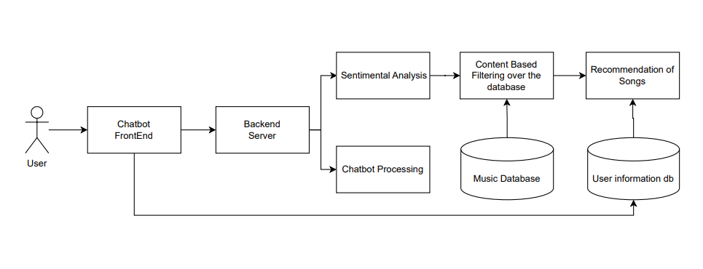
Proposed System Architecture Diagram
29 – 07 - 2024

Slide 9
Project Framework (Hardware / Software)
Hardware Requirements:
Network Connection
Memory and Storage.
CPU and RAM
Software Requirements:
Pyhon 3.10
Web Browser supporting Java Scripts
29 – 07 - 2024

Slide 10
Modules (Explanation of Architecture Diagrams)
User Profiling Module:Builds user profiles based on their preferences, listening history, and demographics.
Music Data Management Module: Stores and manages music and user preferences.
User: The individual interacting with the chatbot or system.
Chatbot Frontend: The user interface through which users interact with the chatbot.
Backend Server: The infrastructure that processes requests, manages data, and supports the chatbot’s functionality.
Chatbot Process: Manages the conversation flow, tracks user interactions, and provides appropriate responses.
Sentiment Analysis: The technique used to determine the emotional tone of user input.
Content-Based Filtering: A method that recommends items based on the similarity between the content of the items and user preferences.
Recommendation of Songs: The system feature that suggests songs to users based on their preferences.
29 – 07 - 2024

Slide 11
Algorithm Used
Collaborative Filtering:
This approach identifies users with similar tastes and recommends music enjoyed by those users.
Content-Based Filtering:
This method focuses on the characteristics of the music itself. The chatbot might analyze audio features like tempo, genre tags, or lyrical content to recommend songs similar to what the user has enjoyed previously.
Matrix Factorization:
This technique helps identify hidden patterns in user-item interactions
29 – 07 - 2024

Slide 12
Thank You !!!

